Slide 1



5·20
你有温良心一颗，我有心上人一个，比花娇艳，比风缠绵，比天地更有缘。感谢你我相遇，此生有你。

Slide 2


01 单击输入标题
02 单击输入标题
目录
03 单击输入标题
CONTENTS
04 单击输入标题

Slide 3


01
添加标题
We used to look up at the sky and wonder at our place in the stars, now we just look down and worry about our place in the dirt.

Slide 4
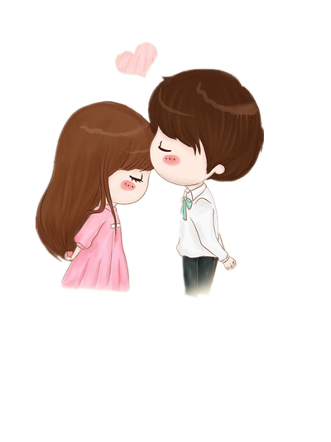

“
亲爱的，情人节快乐！
We used to look up at the sky and wonder at our place in the stars, now we just look down and worry about our place in the dirt. Love is the eternal power, can transcend all dimensions, when I return, you have been old, I breathe again across your life time.
LOVE YOU
We used to look up at the sky and wonder at our place in the stars, now we just look down and worry about our place in the dirt.

Slide 5



LOVE YOU
We used to look up at the sky and wonder at our place in the stars, now we just look down and worry about our place in the dirt. and worry about our place in the dirt. and worry about our place in the dirt.

Slide 6


“
亲爱的，情人节快乐！
We used to look up at the sky and wonder at our place in the stars, now we just look down and worry about our place in the dirt.

Slide 7



LOVE YOU
We used to look up at the sky and wonder at our place in the stars, now we just look down and worry about our place in the dirt.
亲爱的，情人节快乐！
We used to look up at the sky and wonder at our place in the stars, now we just look down and worry about our place in the dirt. Love is the eternal power, can transcend all dimensions, when I return, you have been old, I breathe again across your life time.

Slide 8
02
添加标题
We used to look up at the sky and wonder at our place in the stars, now we just look down and worry about our place in the dirt.

Slide 9



LOVE YOU
We used to look up at the sky and wonder at our place in the stars, now we just look down and worry about our place in the dirt. and worry about our place in the dirt. and worry about our place in the dirt.

Slide 10

“
亲爱的，情人节快乐！
We used to look up at the sky and wonder at our place in the stars, now we just look down and worry about our place in the dirt. Love is the eternal power, can transcend all dimensions, when I return, you have been old, I breathe again across your life time.

Slide 11




LOVE YOU
We used to look up at the sky and wonder at our place in the stars, now we just look down and worry about our place in the dirt. and worry about our place in the dirt. and worry about our place in the dirt.

Slide 12


“
亲爱的，情人节快乐！
We used to look up at the sky and wonder at our place in the stars, now we just look down and worry about our place in the dirt. Love is the eternal power, can transcend all dimensions, when I return, you have been old, I breathe again across your life time.
LOVE YOU
We used to look up at the sky and wonder at our place in the stars, now we just look down and worry about our place in the dirt.

Slide 13
03
添加标题
We used to look up at the sky and wonder at our place in the stars, now we just look down and worry about our place in the dirt.

Slide 14

“
亲爱的，情人节快乐！
We used to look up at the sky and wonder at our place in the stars, now we just look down and worry about our place in the dirt. Love is the eternal power, can transcend all dimensions, when I return, you have been old, I breathe again across your life time。

Slide 15


“
亲爱的，
情人节快乐！
We used to look up at the sky and wonder at our place in the stars, now we just look down and worry about our place in the dirt. Love is the eternal power, We used to look up at the sky and wonder at our place in the stars, now we just look down and worry about our place in the dirt. Love is the eternal power,
We used to look up at the sky and wonder at our place in the stars, now we just look down and worry about our place in the dirt. Love is the eternal power,
LOVE
We used to look up at the sky and wonder at our place in the stars, now we just look down and worry about our place in the dirt.

Slide 16



“
亲爱的，情人节快乐！
We used to look up at the sky and wonder at our place in the stars, now we just look down and worry about our place in the dirt. Love is the eternal power, can transcend all dimensions,
LOVE
We used to look up at the sky and wonder at our place in the stars, now we just look down and worry about our place in the dirt. Love is the eternal power, can transcend all dimensions,

Slide 17


“
亲爱的，情人节快乐！
We used to look up at the sky and wonder at our place in the stars, now we just look down and worry about our place in the dirt. Love is the eternal power, We used to look up at the sky and wonder at our place in the stars, now we just look down and worry about our place in the dirt. Love is the eternal power,
We used to look up at the sky and wonder at our place in the stars, now we just look down and worry about our place in the dirt. Love is the eternal power,

Slide 18
04
添加标题
We used to look up at the sky and wonder at our place in the stars, now we just look down and worry about our place in the dirt.

Slide 19


“
亲爱的，情人节快乐！
We used to look up at the sky and wonder at our place in the stars, now we just look down and worry about our place in the dirt.
LOVE YOU
We used to look up at the sky and wonder at our place in the stars, now we just look down and worry about our place in the dirt. Love is the eternal power, can transcend all dimensions, We used to look up at the sky and wonder at our place in the stars, now we just look down and worry about our place in the dirt.

Slide 20
亲爱的，情人节快乐！
We used to look up at the sky and wonder at our place in the stars, now we just look down and worry about our place in the dirt.
LOVE YOU

Slide 21


LOVE YOU
We used to look up at the sky and wonder at our place in the stars, now we just look down and worry about our place in the dirt. Love is the eternal power, can transcend all dimensions
We used to look up at the sky and wonder at our place in the stars, now we just look down and worry about our place in the dirt. Love is the eternal power, can transcend all dimensions,

Slide 22

LOVE YOU
We used to look up at the sky and wonder at our place in the stars, now we just look down and worry about our place in the dirt. Love is the eternal power, can transcend all dimensions, We used to look up at the sky and wonder at our place in the stars, now we just look down and worry about our place in the dirt.
We used to look up at the sky and wonder at our place in the stars, now we just look down and worry about our place in the dirt. Love is the eternal power, can transcend all dimensions, We used to look up at the sky and wonder at our place in the stars, now we just look down and worry about our place in the dirt.
“
亲爱的，情人节快乐！
We used to look up at the sky and wonder at our place in the stars, now we just look down and worry about our place in the dirt.

Slide 23

LOVE YOU

