Slide 1
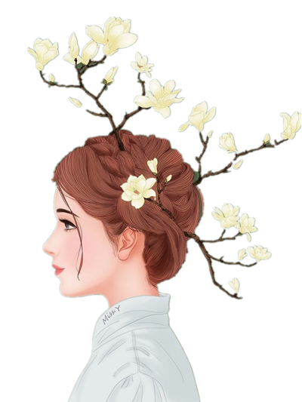
FOR YOUR
创意
Just for today I will try to live through this day only and not tackle my whole life problem at once. Just for today I will try to live through this

Slide 2
01 点 击 添 加 标 题
Just for today I will try to live through this day only and not tackle my whole life problem at once. only and not tackle my whole life problem at once.
目录
02 点 击 添 加 标 题
Just for today I will try to live through this day only and not tackle my whole life problem at once. only and not tackle my whole life problem at once.
03 点 击 添 加 标 题
Just for today I will try to live through this day only and not tackle my whole life problem at once. only and not tackle my whole life problem at once.
04 点 击 添 加 标 题
Just for today I will try to live through this day only and not tackle my whole life problem at once. only and not tackle my whole life problem at once.

Slide 3
第 一 部 分
The waves beside them danced; but they Out-did the sparkling waves in glee: A poet could not but be gay The waves beside them danced; but they Out-did the sparkling waves in glee: A poet could not but be gay The waves beside them danced; but they Out-did

Slide 4

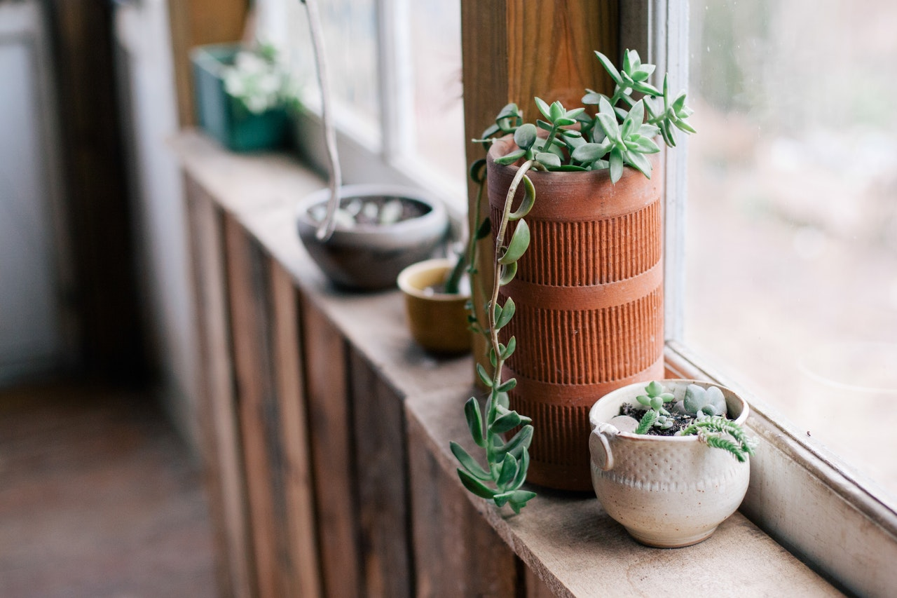
YOUR TITLE
The waves beside them danced; but they Out-did the sparkling waves in glee: A poet could not but be gay The waves
YOUR TITLE
The waves beside them danced; but they Out-did the sparkling waves in glee: A poet could not but be gay The waves

Slide 5

1
Just for today I will exercise my soul in three ways. I will do somebody a good turn and not get found out: If anybody knows of it,
2
Just for today I will exercise my soul in three ways. I will do somebody a good turn and not get found out: If anybody knows of it,
3
Just for today I will exercise my soul in three ways. I will do somebody a good turn and not get found out: If anybody knows of it,

Slide 6

HERE IS YOUR TITLE
The waves beside them danced; but they Out-did the sparkling waves in glee:
A poet could not but be gay The waves beside them danced; but they Out-did the sparkling waves in glee: A poet could not but be gay The waves beside them danced;
The waves beside them danced; but they Out-did the sparkling waves in glee:
A poet could not but be gay The waves beside them danced; but they Out-did the sparkling waves in glee: A poet could not but be gay The waves beside them danced;

Slide 7
点 击 标 题
点 击 标 题
Just for today I will try to live through this day only and not tackle my whole life problem at once. Just for today I will try to live through this day only and not tackle my whole life problem at once.
Just for today I will try to live through this day only and not tackle my whole life problem at once. Just for today I will try to live through this day only and not tackle my whole life problem at once.
Just for today I will try to live through this day only and not tackle my whole life problem at once. Just for today I will try to live through this day only and not tackle my whole life problem at once.
Just for today I will try to live through this day only and not tackle my whole life problem at once. Just for today I will try to live through this day only and not tackle my whole life problem at once.

Slide 8
The waves beside them danced; but they Out-did the sparkling waves in glee: A poet could not but be gay The waves beside them danced
The waves beside them danced; but they Out-did the sparkling waves in glee: A poet could not but be gay The waves beside them danced
The waves beside them danced; but they Out-did the sparkling waves in glee: A poet could not but be gay The waves beside them danced

Slide 9
第 二 部 分
The waves beside them danced; but they Out-did the sparkling waves in glee: A poet could not but be gay The waves beside them danced; but they Out-did the sparkling waves in glee: A poet could not but be gay The waves beside them danced; but they Out-did

Slide 10
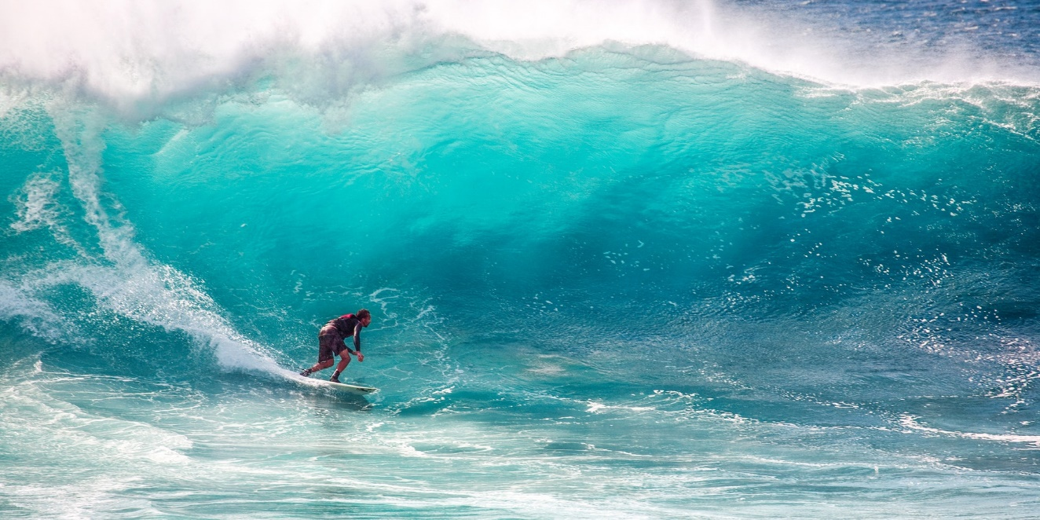
不/散/青/春/
点击输入本栏的具体文字，简明扼要的说明分项内容
点击输入本栏的具体文字，简明扼要的说明分项内容

Slide 11
YOUR TITLE
YOUR TITLE
The waves beside them danced; but they Out-did the sparkling waves
The waves beside them danced; but they Out-did the sparkling waves

Slide 12
Tittle here
ideas
The waves beside them danced; but they Out-did the sparkling waves in glee: A poet could not but be gay The waves beside them danced; but they Out-did the sparkling waves in glee: A poet could not but be gay The waves beside them danced; but they Out-did
Tittle here
revise
The waves beside them danced; but they Out-did the sparkling waves in glee: A poet could not but be gay The waves beside them danced; but they Out-did the sparkling waves in glee: A poet could not but be gay The waves beside them danced; but they Out-did

Slide 13
HERE IS YOUR TITLE
The waves beside them danced; but they Out-did the sparkling waves in glee: A poet could not but be gay The waves
HERE IS YOUR TITLE
The waves beside them danced; but they Out-did the sparkling waves in glee: A poet could not but be gay The waves

Slide 14
第 三 部 分
The waves beside them danced; but they Out-did the sparkling waves in glee: A poet could not but be gay The waves beside them danced; but they Out-did the sparkling waves in glee: A poet could not but be gay The waves beside them danced; but they Out-did

Slide 15
ADD YOUR TITTLE
Just for today I will try to live this day only and not tackle my whole life problem at
ADD YOUR TITTLE
Just for today I will try to live this day only and not tackle my whole life problem at
ADD YOUR TITTLE
Just for today I will try to live this day only and not tackle my whole life problem at
ADD YOUR TITTLE
Just for today I will try to live this day only and not tackle my whole life problem at

Slide 16
第 四 部 分
The waves beside them danced; but they Out-did the sparkling waves in glee: A poet could not but be gay The waves beside them danced; but they Out-did the sparkling waves in glee: A poet could not but be gay The waves beside them danced; but they Out-did

Slide 17

ADD YOUR TITTLE HERE
Just for today I will try to live through this day only and not tackle my whole life problem at once Just for today I will try to live through this day only and not tackle my whole life problem at once. tackle my whole life problem at once Just for today I will
ADD YOUR TITTLE HERE
Just for today I will try to live through this day only and not tackle my whole life problem at once Just for today I will try to live through this day only and not tackle my whole life problem at once. tackle my whole life problem at once Just for today I will

Slide 18
FOR YOUR
謝謝
Just for today I will try to live through this day only and not tackle my whole life problem at once. Just for today I will try to live through this

